Slide 1
DFW Company: Celebrations effects on Revenue Sources
A Google Sheets Exploration by Bennett Frohock

Slide 2
The Celebrations Problem
This data is regarding a growing celebrations program at a popular company. Although the companies main source of revenue comes from merchandise and tickets sold to their interactive show, families can host birthdays and other events at company locations as part of the Celebrations program. This program is a growing part of the business especially in the last year.
When a store hosts a celebration is the team stretched too thin to engage properly with guests? Resulting in lower sales?
Do shows canceled to accommodate celebrations lead to a loss of ticket revenue or less traffic due to tickets being unavailable? Or are those tickets funneled into neighboring time slots.
How much do celebrations really contribute to revenue? Is there a loss in ticket or merchandise revenue on days with celebrations? If so how much loss or additional gain is made on days with celebrations?

Slide 3
Let’s Find Out!
The aim of this project is to determine the difference in revenue for days with and without celebrations in order to gain a better understanding on their true effect on store revenue.
We will separate our data by day of the week in order to control for daily differences in traffic.
The data is further grouped by days with at least one celebration versus those with none.
Using this analyses we can recommend changes to the celebrations system to maximize revenue!

Slide 4
Data Sources
Data was gathered by manual data entry from CAMP Dallas on Looker to a google sheets doc
Data from celebrations, merchandise and show tickets revenue, as well as traffic and KPIs were collected from Nov. 1 2022 to Nov. 1 2023.
The data was cleaned of duplicate rows and missing data.
The data was validated against Looker totals. There was some variation within sources but total revenue was within $500 of Looker.

Slide 5

Which Days should we consider?

Slide 6
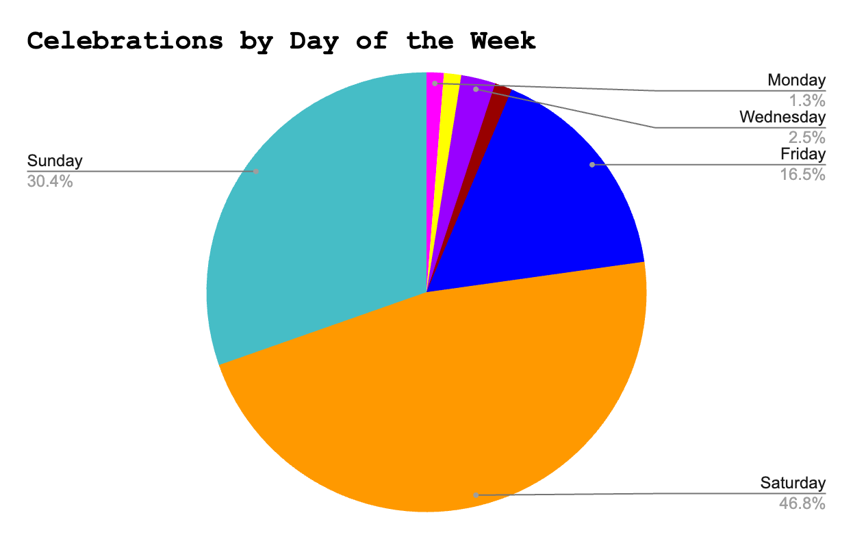

Slide 7
Weekends are best for now.
As there were only a few celebrations on Monday, Tuesday, Wednesday and Thursday in our Dataset, it is not enough data for an accurate analysis. So for this project we will stick to Friday, Saturday and Sunday where over 90% of the Celebrations took place.
Weekdays may also show different trends as weekends and will be saved to be analyzed another day.
For now we will define weekends as Friday, Saturday and Sunday.
Additionally, going forward we will look at the data through the lens of dates with 1 or more celebrations and those without.

Slide 8
Ok, so how do weekends with celebrations perform compared to those without?

Slide 9
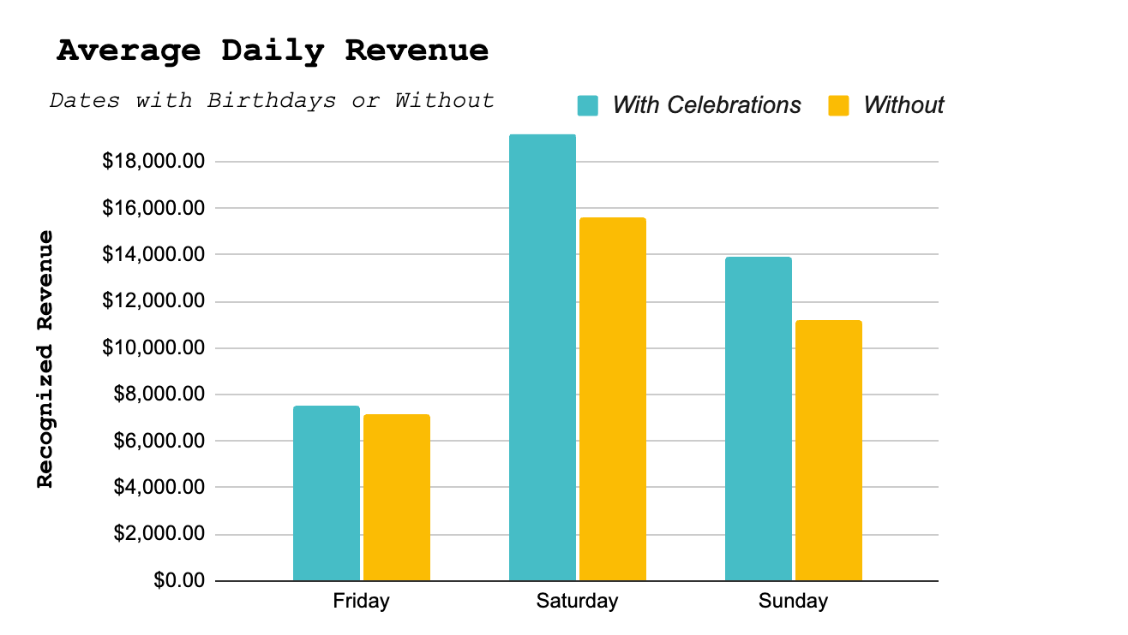

Slide 10
That was Expected
Weekend days with celebrations perform better than those without. This is expected as celebrations account for a large chunk of revenue.
Weekend days with at least one celebration earn on average $2,717.36 (weighted by number of celebrations/day) more than weekend days without any celebrations.
Where is this all coming from?
Some of this revenue is from the celebrations themselves. The average weekend day with a celebration made $2079.59 from parties alone.

Slide 11

What about the other $637.77/day?

Slide 12
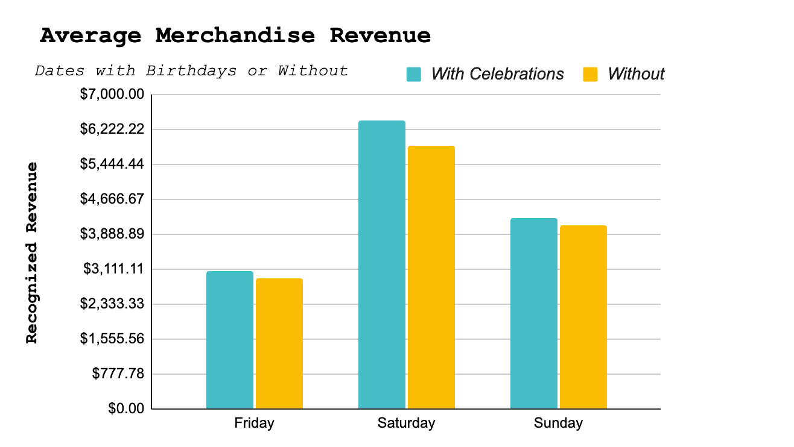

Slide 13
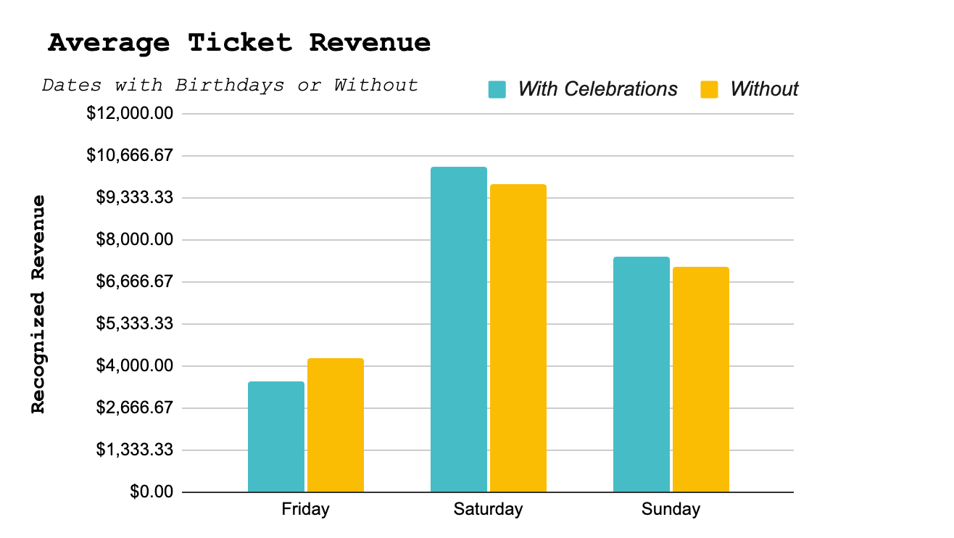
Not sure why Fridays saw a decrease here. More data is needed.

Slide 14
Weekend Days with Celebrations did better in other revenue categories.
Weekend Days with Celebrations drove an average of $370.57 additional merchandise sales a day
Weekend Days with at least one celebration saw an additional $267.20 on average per day in show revenue.
For a total of $637.77/Day

Slide 15
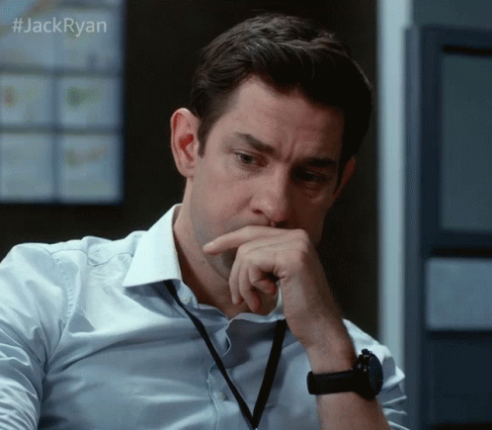
But how are celebrations driving sales in other categories?

Slide 16
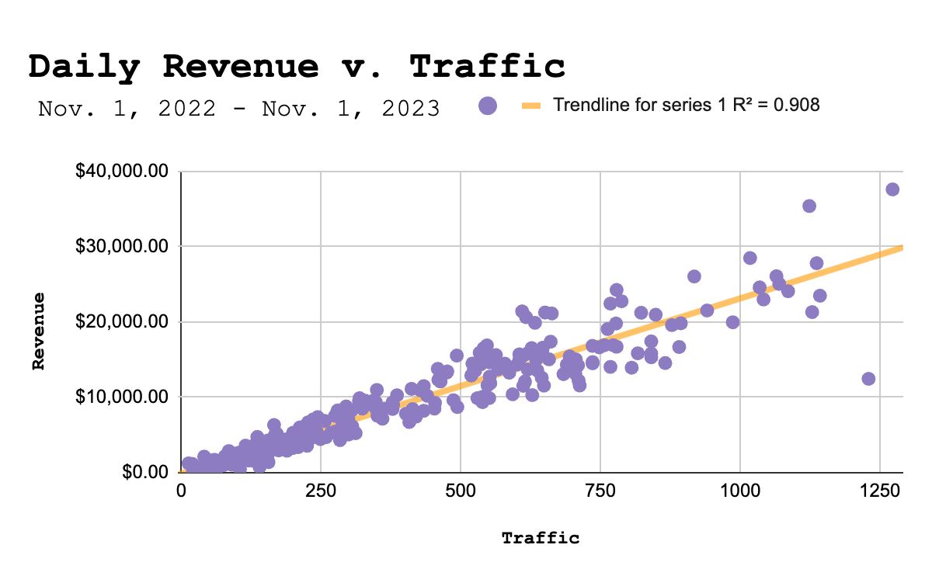

Slide 17
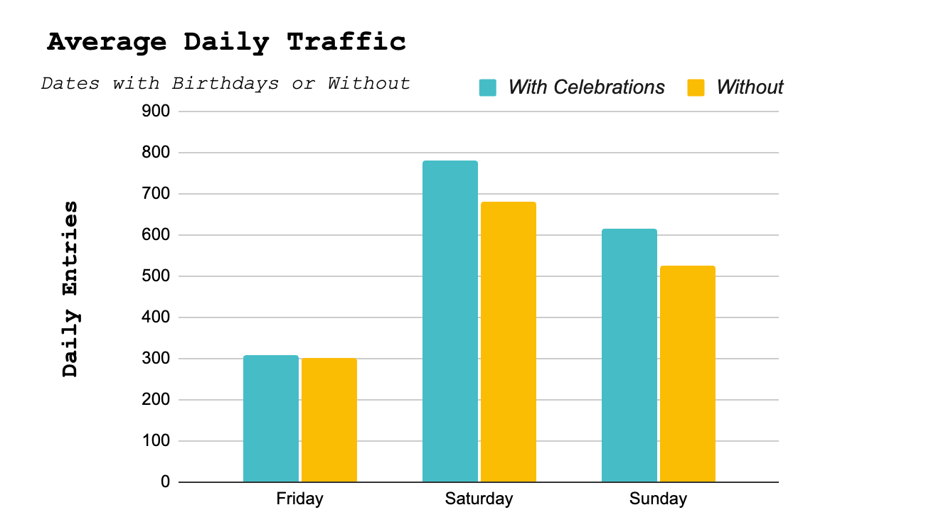

Slide 18
Traffic drives sales!
In-store sales go hand-in-hand with store traffic
Weekend days with at least one celebration drove on average 80.49 more entrances than days without no celebrations.
It is hard to say what the nature of the correlation truly is. Do birthdays drive traffic? Or do Celebrations tend to book on what already might be busy days?
A lot of CAMPs busiest days such as holidays and special events, prevent the booking of Celebrations. So there may be reason to believe that Celebrations are having a significant impact on store traffic.

Slide 19
In conclusion… Book More Birthdays!
The company should continue pushing celebration sales as they seem to have no negative impact on other sources of revenue.
In fact, there is evidence to support the notion that CAMP celebrations help to increase revenue from other sources by driving more traffic. Larger data pools may help determine the true nature of this relationship in the future.
The company should implement programs (like the 10% off for celebrations guests) to help convert birthday traffic into more sales.
The company could consider lowering birthday prices, if there was reason to believe that it would draw more celebration sales, as the lost revenue from the lower pricing may be made up in the revenue generated from the additional birthday traffic.

Slide 20

Questions?

